Slide 1
Tensor Products, Superposition, and Entanglement
Dr. Moshiur Rahman
Stevens Institute of Technology

Slide 2
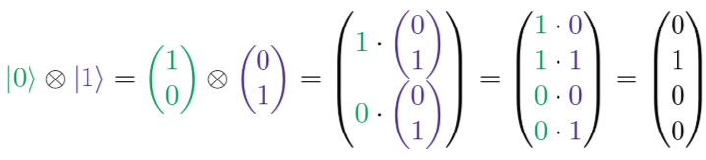
Tensor Product, Superposition, and Quantum Entanglement
Quantum Computing utilizes two major features of Quantum Mechanics:
Superposition
Refers to the quantum phenomenon where Quantum System can exist in multiple
states or places at the same time
Entanglement
A special case of superposition
Is an extremely strong correlation that exists between two or more quantum particles
These particles are so inextricably linked that even if separated by great distance, they change
the states instantaneously in perfect unison
Some knowledge of Tensor products is needed to understand the two features
Quantum Information processing systems in general use multiple qubits
Joint state of multi-qubit system can be described by a special operation, known as Tensor Product,

Slide 3

Tensor Products
How do we think about combined states in vector form? We use a tensor product!
The tensor product between two qubit vectors is defined as following:
It may be easier to think of a tensor product as ‘distributing’ a vector, or FOILing.
The tensor product can also be used on matrices. The right term is distributed to every element inside the left matrix.

Slide 4
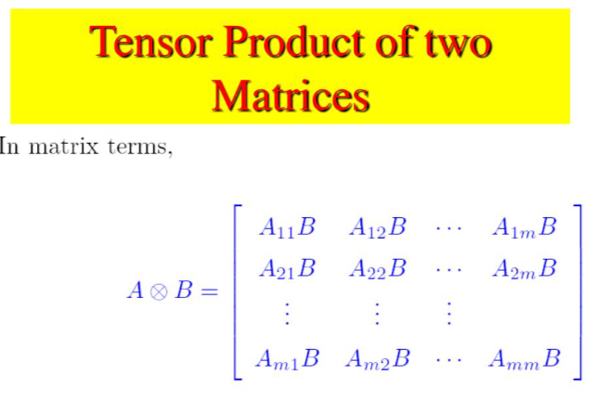
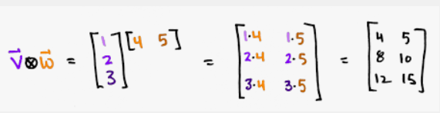
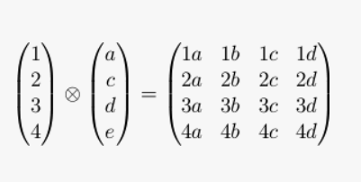
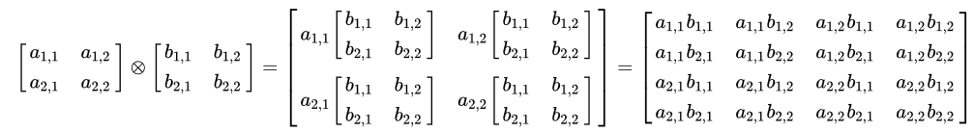
Tensor Product Examples

Slide 5
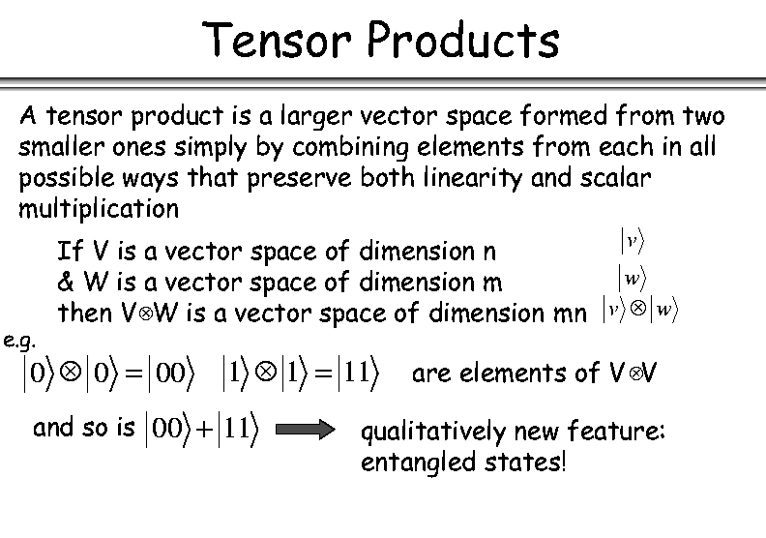
Tensor Products of Vector Spaces
Notation for vectors in space V
^{Note various}
^{notations}

Slide 6
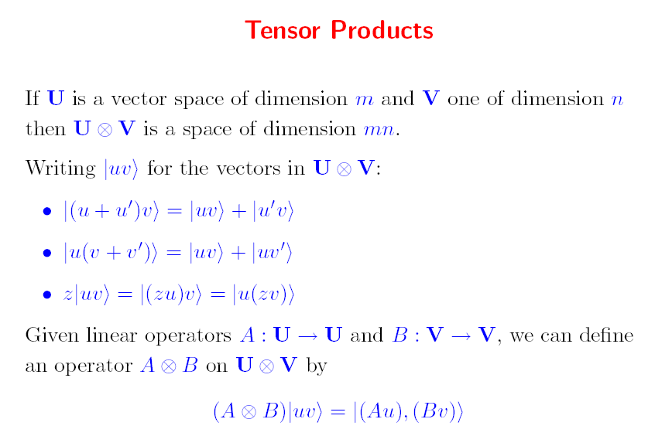
Tensor Products of vectors and Tensor Products of Operators
Properties of tensor products for vectors
Tensor product for operators

Slide 7
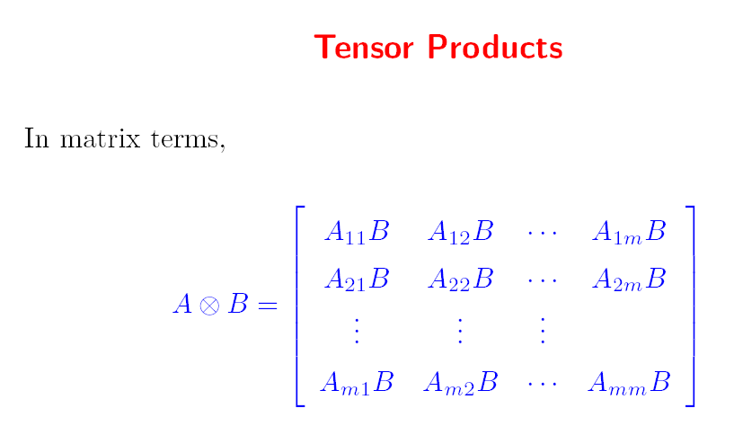
Tensor Product of two Matrices

Slide 8
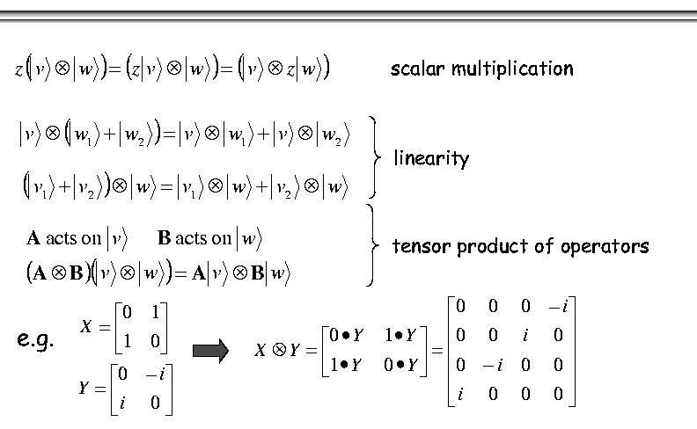
Properties of Tensor Products of vectors and operators
These can be vectors of any size
We repeat them in different notation here

Slide 9

Quantum Registers
A quantum register is a collection of qubits used in one circuit.
A quantum register has one state which represents the states of all of its qubits.
Previously, we thought about combining states in ket notation:
|0⟩ |0⟩ → |00⟩
( |0⟩ + |1⟩ ) |0⟩ → ( |00⟩ + |10⟩ )

Slide 10

Basis States in a 2-Qubit Register
There are 2^{n} basis states in an n qubit register, so for 2 qubits there are:
In general, the basis state is |i⟩, where i is a binary number between 0 and 2^{n}.
This basis state forms the vector filled with 0s and has a 1 at the i ^{th} index.

Slide 11
Basic Properties of Tensor Products
The product of any scalar s with tensor product A ⊗ B is equal to
s(A ⊗ B) = (sA) ⊗ B = A ⊗ (sB)
Conjugate transpose is distributive. So is inverse and transpose.
(A ⊗ B)† = (A† ⊗ B†)
If A is an m x n matrix and B is a p x q matrix, then their tensor product is an mp x nq matrix.
If A, B, C, and D are matrices then
A ⊗ (B + C) = (A ⊗ B) + (A ⊗ C)
A ⊗ (B ⊗ C) = (A ⊗ B) ⊗ C
(A ⊗ B)(C ⊗ D) = (AC) ⊗ (BD)

Slide 12
Basic Properties of Tensor Products cont.
If A and B are matrices and U, V, and W are vectors, then
(A ⊗ B)(U ⊗ W) = AU ⊗ BW
(U + V) ⊗ W = U ⊗ W + V ⊗ W
U ⊗ (V + W) = U ⊗ V + U ⊗ W
If s and t are scalars, then
sU ⊗ tV = st(U ⊗ V)

Slide 13
Multi-Qubit Systems
Looking at two general qubit states in ket notation:
|Ψ₀⟩ = α₀|0⟩ + β₀|1⟩ and |Ψ₁⟩ = α₁|0⟩ + β₁|1⟩
We can combine them into a register by taking the tensor product |Ψ₀⟩ ⊗ |Ψ₁⟩
|Ψ⟩ = ( α₀|0⟩ + β₀|1⟩ ) ⊗ ( α₁|0⟩ + β₁|1⟩ )
|Ψ⟩ = α₀α₁|00⟩ + α₀β₁|01⟩ + β₀α₁|10⟩ + β₀β₁|11⟩
When we talk about multi-qubit systems we tend to drop the α and β
|Ψ⟩ = c₀|00⟩ + c₁|01⟩ + c₂|10⟩ + c₃|11⟩ where |c₀|² + |c₁|² + |c₂|² + |c₃|² = 1

Slide 14

Superposition
Equal superposition is the state where a quantum register of |0...0⟩ has a Hadamard gate applied to each qubit in the circuit. This creates the state
This state is one of the most important states in all of quantum computing. The superposition ensures the probability of any outcome is equal to every other outcome.

Slide 15
Quantum Algorithms
Why is equal superposition so useful in quantum computing? Nearly every quantum algorithm starts in this state and then uses a sequence of gates to increase the probability of a desired outcome and decrease the probabilities of undesired outcomes.
Why are quantum computers so much faster? Because one gate changes the probabilities of every outcome, not just one. This means a single gate affects 2^{n} different outcomes, which is where the incredible parallelism comes from.
Of course since quantum computers collapse randomly there are still some drawbacks to using them.

Slide 16
Entanglement
Entanglement is a unique kind of correlation that exists in quantum particles. EPR (Einstein, Podolsky, Rosen) showed that two particles in a register may be correlated such that any measurement on one particle identifies the outcome of the same measurement on its partner particle, irrespective of how wide the physical distance between them.
This phenomenon is so strange that Einstein called it “spooky action at a distance”.

Slide 17
Predicting States from Entanglement
Given the state ( |01⟩ + |10⟩ ) we can see it is entangled because there are no two separate states which can be tensored together to create this state.
If we measure the first qubit and it is 0 then we know the state it came from was the |01⟩ because there are no other states which have a zero in the first qubit position. This guarantees that the second qubit will be 1.
On the other hand, if the outcome of the first qubit was 1, then the state it came from was |10⟩ and the second qubit will be 0.

Slide 18
Unpredictable Entangled States
Say there exists some entangled state: |Ψ⟩ = c₀|00⟩ + c₁|01⟩ + c₂|10⟩ + c₃|11⟩
This state can’t be broken down into separate states. Also, the second qubit cannot be predicted after measuring the first.
If the first qubit was measured as 0, the second qubit could still be 0 or 1, we can’t tell. Furthermore, we can’t determine the probabilities of the second qubit without measuring it several times.

Slide 19
Bell States
There are four states which are important in entanglement. These Bell states are called maximally entangled because they are totally predictable. They are:
|Φ⁺⟩ = ( |00⟩ + |11⟩ )
|Ψ⁺⟩ = ( |01⟩ + |10⟩ )
|Φ⁻⟩ = ( |00⟩ - |11⟩ )
|Ψ⁻⟩ = ( |01⟩ - |10⟩ )

Slide 20
Decoherence
Decoherence is an undesirable effect in quantum systems. Any state in superposition can collapse randomly when interacting with their environment.
This is why quantum computers are stored in low vibration containers, at near absolute zero temperatures, shielded from magnetic fields.
The more qubits entangled together in a circuit, the higher the rate of decoherence. Modern quantum computers are limited by this factor since large, poorly designed QCs will be too unstable to do any meaningful work.
Quantum Error Correction is a possible method of fixing the issue of decoherence.

